Slide 1
Intermediate Code Generation in Compiler Design

Slide 2
What is Intermediate Code Generation?
Intermediate Code Generation is a stage in the process of compiling a program, where the compiler translates the source code into an intermediate representation.
This representation is not machine code but is simpler than the original high-level code.

Slide 3
Here’s how it works:
Translation: The compiler takes the high-level code (like C or Java) and converts it into an intermediate form, which can be easier to analyze and manipulate.
Portability: This intermediate code can often run on different types of machines without needing major changes, making it more versatile.
Optimization: Before turning it into machine code, the compiler can optimize this intermediate code to make the final program run faster or use less memory.

Slide 4
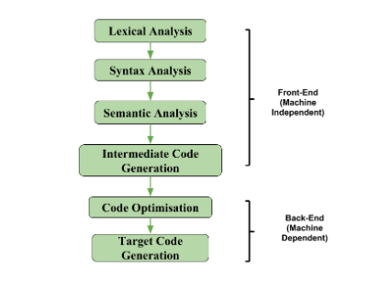

Slide 5
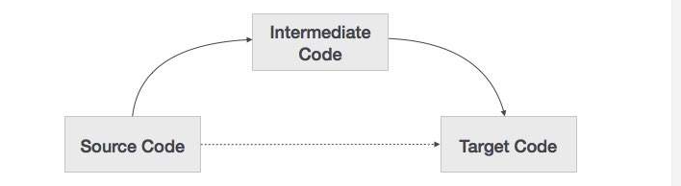
why we need an intermediate code?
for each new machine, a full native compiler is required.
eliminates the need of a new full compiler for every unique machine by keeping the analysis portion same for all the compilers.

Slide 6
why we need an intermediate code? Cont..
The second part of compiler, synthesis, is changed according to the target machine.
It becomes easier to apply the source code modifications to improve code performance by applying code optimization techniques on the intermediate code.

Slide 7
Intermediate Representation
High Level IR
High-level intermediate code representation is very close to the source language itself.
They can be easily generated from the source code
we can easily apply code modifications to enhance performance.
But for target machine optimization, it is less preferred.

Slide 8
Intermediate Representation
Low Level IR -
This one is close to the target machine, which makes it suitable for register and memory allocation, instruction set selection, etc.
It is good for machine-dependent optimizations.
Intermediate code can be either language specific (e.g., Byte Code for Java) or language independent (three-address code).

Slide 9
commonly used intermediate code representations:
1. Postfix Notation
2. Three-Address Code
3. Syntax Tree

Slide 10
Postfix Notation
Also known as reverse Polish notation or suffix notation.
In the infix notation, the operator is placed between operands, e.g., a + b. Postfix notation positions the operator at the right end, as in ab +.
For any postfix expressions e1 and e2 with a binary operator (+) , applying the operator yields e1e2+.

Slide 11
Postfix Notation cont..
Postfix notation eliminates the need for parentheses, as the operator’s position and arity allow unambiguous expression decoding.
In postfix notation, the operator consistently follows the operand.
Example 1: The postfix representation of the expression (a + b) * c is : ab + c * Example 2: The postfix representation of the expression (a – b) * (c + d) + (a – b) is : ab – cd + *ab -+

Slide 12
Three-Address Code
A three address statement involves a maximum of three references, consisting of two for operands and one for the result.
A sequence of three address statements collectively forms a three address code.
The typical form of a three address statement is expressed as x = y op z, where x, y, and z represent memory addresses.
Each variable (x, y, z) in a three address statement is associated with a specific memory location.

Slide 13
Three-Address Code
Intermediate code generator receives input from its predecessor phase, semantic analyzer, in the form of an annotated syntax tree.
That syntax tree then can be converted into a linear representation, e.g., postfix notation. Intermediate code tends to be machine independent code.

Slide 14
Three-Address Code
Example a = b + c * d;
The intermediate code generator will try to divide this expression into sub-expressions and then generate the corresponding code.
r1 = c * d;
r2 = b + r1;
a = r2

Slide 15
cont..
There are 3 ways to represent a Three-Address Code in compiler design: i) Quadruples ii) Triples iii) Indirect Triples

Slide 16
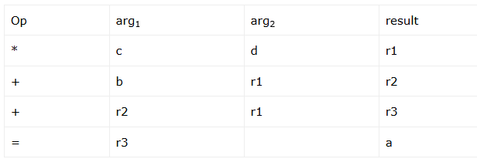
Quadruples
Each instruction in quadruples presentation is divided into four fields: operator, arg1, arg2, and result. The above example is represented below in quadruples format:

Slide 17
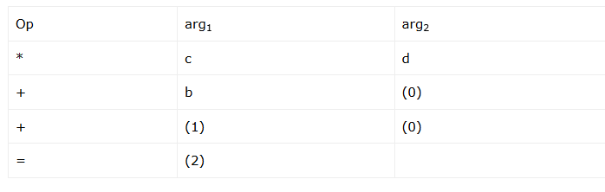
Triples
Each instruction in triples presentation has three fields : op, arg1, and arg2

Slide 18
Indirect Triples
This representation is an enhancement over triples representation.
It uses pointers instead of position to store results. This enables the optimizers to freely re-position the sub-expression to produce an optimized code.

Slide 19
Advantages of Intermediate Code Generation
Easier to Implement: Intermediate code generation can simplify the code generation process by reducing the complexity of the input code, making it easier to implement.
Facilitates Code Optimization: Intermediate code generation can enable the use of various code optimization techniques, leading to improved performance and efficiency of the generated code.

Slide 20
Advantages of Intermediate Code Generation cont..
Platform Independence: Intermediate code is platform-independent, meaning that it can be translated into machine code or bytecode for any platform.
Code Reuse: Intermediate code can be reused in the future to generate code for other platforms or languages.
Easier Debugging: Intermediate code can be easier to debug than machine code or bytecode, as it is closer to the original source code.

Slide 21
Disadvantages of Intermediate Code Generation
Increased Compilation Time: Intermediate code generation can significantly increase the compilation time, making it less suitable for real-time or time-critical applications.
Additional Memory Usage: Intermediate code generation requires additional memory to store the intermediate representation, which can be a concern for memory-limited systems.

Slide 22
Disadvantages of Intermediate Code Generation
Increased Complexity: Intermediate code generation can increase the complexity of the compiler design, making it harder to implement and maintain.
Reduced Performance: The process of generating intermediate code can result in code that executes slower than code generated directly from the source code.

Slide 23
Code optimization

Slide 24
Code Optimization
Optimization is a program transformation technique, which tries to improve the code by making it consume less resources (i.e. CPU, Memory) and deliver high speed.
In optimization, high-level general programming constructs are replaced by very efficient low-level programming codes. A code optimizing process must follow the three rules given below:

Slide 25
1. The output code must not, in any way, change the meaning of the program.
2. Optimization should increase the speed of the program and if possible, the program should demand less number of resources.
3. Optimization should itself be fast and should not delay the overall compiling process.

Slide 26
Optimization levels
At the beginning, users can change/rearrange the code or use better algorithms to write the code.
After generating intermediate code, the compiler can modify the intermediate code by address calculations and improving loops.
While producing the target machine code, the compiler can make use of memory hierarchy and CPU registers.

Slide 27
Types of Optimization
Optimization can be categorized broadly into two types :
1. machine independent
2. machine dependent.

Slide 28
Machine-independent Optimization
the compiler takes in the intermediate code and transforms a part of the code that does not involve any CPU registers and/or absolute memory locations.
For example:
Item = 10;
do
{
value = value + item;
} while(value<100);
do { item = 10; value = value + item; } while(value<100);

Slide 29
Machine-dependent Optimization
Machine-dependent optimization is done after the target code has been generated and when the code is transformed according to the target machine architecture.
It involves CPU registers and may have absolute memory references rather than relative references. Machine-dependent optimizers put efforts to take maximum advantage of memory hierarchy.

Slide 30
When to Optimize?
Optimization of the code is often performed at the end of the development stage since it reduces readability and adds code that is used to increase performance.

Slide 31
Ways to Optimize Code
Constant Propagation:
If the value of a variable is a constant, then replace the variable with the constant. The variable may not always be a constant
Example
A = 2*(22.0/7.0)*r
Performs 2*(22.0/7.0)*r at compile time.
(ii) x = 12.4 y = x/2.3
Evaluates x/2.3 as 12.4/2.3 at compile time.
(iii) int k=2; if(k) go to L3; It is evaluated as : go to L3 ( Because k = 2 which implies condition is always true
)

Slide 32
Cont…
Constant Folding:
Consider an expression : a = b op c and the values b and c are constants, then the value of a can be computed at compile time.
#define k 5 x = 2 * k y = k + 5 This can be computed at compile time and the values of x and y are : x = 10 y = 10

Slide 33
Cont…
Copy Propagation:
It is extension of constant propagation.
After a is assigned to x, use a to replace x till a is assigned again to another variable or value or expression.
It helps in reducing the compile time as it reduces copying.
//Before Optimization
c = a * b
x = a
till
d = x * b + 4
//After Optimization
d = a * b + 4

Slide 34
Cont..
Common Sub Expression Elimination:
eliminating redundant calculations.
In the above example, a*b and x*b is a common sub expression.
//Before Optimization
c = a * b
x = a
till
d = x * b + 4
//After Optimization
d = a * b + 4

Slide 35
Cont..
Dead Code Elimination:
Copy propagation often leads to making assignment statements into dead code.
A variable is said to be dead if it is never used after its last definition.
In order to find the dead variables, a data flow analysis should be done.

Slide 36
Unreachable Code Elimination:
First, Control Flow Graph should be constructed.
The block which does not have an incoming edge is an Unreachable code block.
After constant propagation and constant folding, the unreachable branches can be eliminated.

Slide 37
#include <iostream>
using namespace std;
int main() {
int num;
num=10;
cout << "GFG!";
return 0;
cout << num; //unreachable code } //after elimination of unreachable code
int main() {
int num; num=10;
cout << "GFG!";
return 0; }

Slide 38
Cont..
Function Inlining:
Here, a function call is replaced by the body of the function itself.
This saves a lot of time in copying all the parameters, storing the return address, etc.

Slide 39
Cont..
Function Cloning:
Here, specialized codes for a function are created for different calling parameters.
Example: Function Overloading

Slide 40
Loop Optimization Techniques
1. Code Motion or Frequency Reduction:
The evaluation frequency of expression is reduced.
The loop invariant statements are brought out of the loop.

Slide 41
Cont..
// Before loop jamming
for(int k=0;k<10;k++)
{ x = k*2; }
for(int k=0;k<10;k++)
{ y = k+3; }
//After loop jamming
for(int k=0;k<10;k++)
{ x = k*2;
y = k+3;
}
Loop Jamming
Two or more loops are
combined in a single loop.
It helps in reducing the compile time.

Slide 42
Cont..
Loop Unrolling
It helps in optimizing the execution time of the program by reducing the iterations.
It increases the program’s speed by eliminating the loop control and test instructions.
//Before Loop Unrolling
for(int i=0;i<2;i++)
{ printf("Hello"); }
//After Loop Unrolling
printf("Hello");
printf("Hello");

Slide 43
Where to Apply Optimization?
Now that we learned the need for optimization and its two types,now let’s see where to apply these optimization.
Source program: Optimizing the source program involves making changes to the algorithm or changing the loop structures. The user is the actor here.
Intermediate Code: Optimizing the intermediate code involves changing the address calculations and transforming the procedure calls involved. Here compiler is the actor.
Target Code: Optimizing the target code is done by the compiler. Usage of registers, and select and move instructions are part of the optimization involved in the target code.

Slide 44
Cont..
Regional Optimization: Transformations are applied to Extended Basic Blocks. Techniques followed are Super Local Value Numbering and Loop Unrolling.
Global Optimization: Transformations are applied to large program segments that include functions, procedures, and loops. Techniques followed are Live Variable Analysis and Global Code Replacement.
Interprocedural Optimization: As the name indicates, the optimizations are applied inter procedurally. Techniques followed are Inline Substitution and Procedure Placement.

Slide 45
Code Generation
The final phase in compiler model is the code generator.
It takes as input an intermediate representation of the source program and produces as output an equivalent target program.

Slide 46
Cont..
Advantages of Code Optimization
Improved performance: Code optimization can result in code that executes faster and uses fewer resources, leading to improved performance.
Reduction in code size: Code optimization can help reduce the size of the generated code, making it easier to distribute and deploy.

Slide 47
Cont..
Increased portability: Code optimization can result in code that is more portable across different platforms, making it easier to target a wider range of hardware and software.
Reduced power consumption: Code optimization can lead to code that consumes less power, making it more energy-efficient.
Improved maintainability: Code optimization can result in code that is easier to understand and maintain, reducing the cost of software maintenance.

Slide 48
Cont..
Disadvantages of Code Optimization
Increased compilation time: Code optimization can significantly increase the compilation time, which can be a significant drawback when developing large software systems.
Increased complexity: Code optimization can result in more complex code, making it harder to understand and debug.

Slide 49
Cont..
Potential for introducing bugs: Code optimization can introduce bugs into the code if not done carefully, leading to unexpected behavior and errors.
Difficulty in assessing the effectiveness: It can be difficult to determine the effectiveness of code optimization, making it hard to justify the time and resources spent on the process.

Slide 50
Cont..

Slide 51
Cont..

Slide 52
Code Generation
The code generated by the compiler is an object code of some lower-level programming language, for example, assembly language.
The source code written in a higher-level language is transformed into a lower-level language that results in a lower-level object code, which should have the following minimum properties:
It should carry the exact meaning of the source code.
It should be efficient in terms of CPU usage and memory management.

Slide 53
ISSUES IN THE DESIGN OF A CODE GENERATOR:
The following issues arise during the code generation phase :
1)Input to code generator
2)Target program
3)Memory management
4)Instruction selection
5)Register allocation
6)Evaluation order

Slide 54
1.Input to code generator
The input to the code generation consists of the intermediate representation of the source program produced by front end , together with information in the symbol table.
Intermediate representation can be : 1)Linear representation such as postfix notation 2)Three address representation such as Quadruples 3)Virtual machine representation such as stack machine code 4)Graphical representations such as syntax trees and dags.

Slide 55
Prior to code generation, the front end must be scanned, parsed and translated into intermediate representation along with necessary type checking.
Therefore, input to code generation is assumed to be error-free.

Slide 56
2.Target program
The output of the code generator is the target program.
The output may be :
A. Absolute machine language: It can be placed in a fixed memory location and can be executed immediately.
B. Relocatable machine language: It allows subprograms to be compiled separately.
C. Assembly language: Code generation is made easier

Slide 57
3.Memory management
Names in the source program are mapped to addresses of data objects in run-time memory.
It makes use of symbol table, that is, a name in a three address statement refers to a symbol-table entry for the name.

Slide 58
4. Instruction selection
1. The instructions of target machine should be complete and uniform.
2. Instruction speeds and machine idioms are important factors when efficiency of target program is considered.
3. The quality of the generated code is determined by its speed and size.

Slide 59
5. Register allocation
Instructions involving register operands are shorter and faster than those involving operands in memory. The use of registers is subdivided into two sub problems :
Register allocation – the set of variables that will reside in registers in the program is selected.
2. Register assignment -the specific register that a variable will reside is selected.

Slide 60
6. Evaluation order
The code generator decides the order in which the instruction will be executed.
The order in which the computations are performed can affect the efficiency of the target code

Slide 61
Some computation orders require fewer registers to hold intermediate results than others.
• Picking the best order is a difficult task.
• Initially avoid this problem by generating code for the three address statements in the order in which they have been produced by the intermediate code generator.
• It creates schedules for instructions to execute them.

Slide 62
7. TARGET MACHINE
The target computer is a byte-addressable machine with 4 bytes to a word.
It has n general-purpose registers, R0, R1, . . . , Rn-1.It has two-address instructions of the form:
op source, destination where, op is an op-code, and source and destination are data fields.

Slide 63
It has the following op-codes : MOV (move source to destination) ADD (add source to destination) SUB (subtract source from destination).
The source and destination of an instruction are specified by combining registers and memory locations with address modes.

Slide 64
Code Generation

